Slide 1

Managing IOS - Routers and Switches
Speaker Name
Job title
Organization

Slide 2


Upgrading IOS on Switch

Slide 3
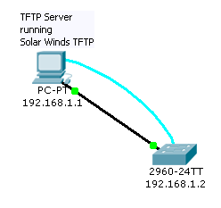
Upgrade Switch IOS using TFTP
Occasional upgrades are needed either for increased functionality or for bug fixes.
A TFTP server is required. Several free versions are available. Solar Winds is being used.
A working Ethernet connection is required between Switch and TFTP server.
We will be using 192.168.1.1/24 on TFTP server and 192.168.1.2/24 on Switch vlan1.

Slide 4
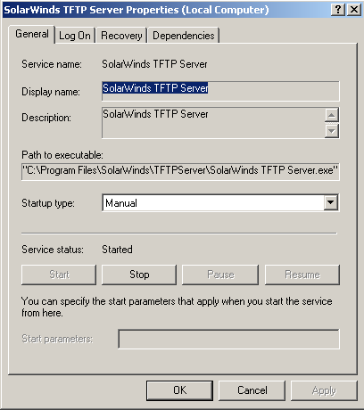
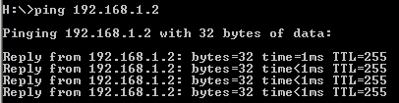
Before you Begin the Transfer…
Make sure your TFTP server has started.
Make sure the IOS file is in the TFTP server directory.
Ping between Server and Switch.

Slide 5
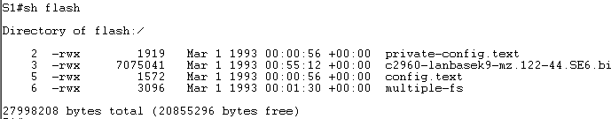


Starting the Transfer
There is ample space for the new IOS, so we’ll leave the old one on the switch for now.
Using a simple syntax, the copy is started:

Slide 6
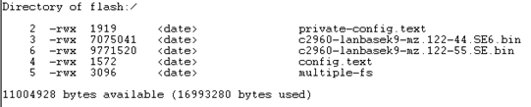

Booting the New IOS
Now the switch has two different IOS binaries in flash. Which one will boot?
By default, the first one listed will boot. This would cause the old IOS to boot in this case. We can tell the switch (or router) to boot a particular IOS with a ‘boot system’ command.

Slide 7
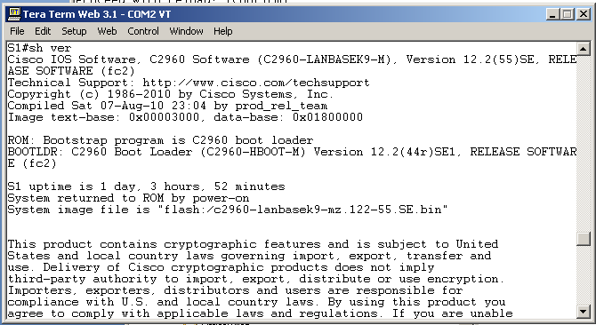
Show version – the New IOS has Loaded!

Slide 8
Missing IOS on Switch

Slide 9
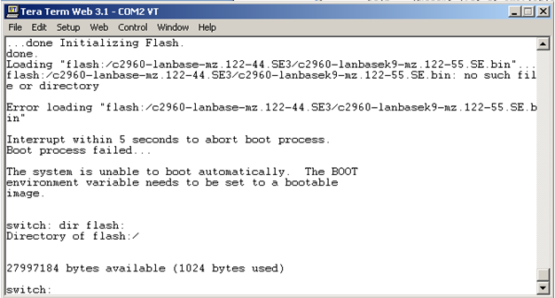
The WORST Case – Switch IOS GONE…
Now What???
Notes:
If the switch is still running – DO NOT power it off! TFTP can be used as illustrated earlier.
The ‘erase flash:’ command may have been issued in error – it can and does happen.
If the switch was then powered off, this is the result when it is next powered on.

Slide 10
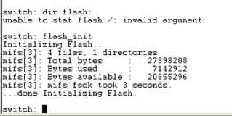
Patience! We can fix it - slowly
You may not be able to ‘see’ the flash memory on the switch.
If not, initialize flash using the ‘flash_init’ command.
TFTP is not available. We will actually transfer the IOS file through the Serial Port/Console Connection using ….. XMODEM!
Notes:
Your switch may or may not automatically initialize flash when powering up. If you get the ‘unable to stat flash’ message, you will need to initialize flash. There will be a ‘reminder’ displayed showing the ‘flash_init’ command.

Slide 11



No! Not the Modem – just the Protocol
Remember – the console connection is running at 9600 bits/sec. Transferring a 9 Meg IOS at that rate will take a little over 2 hours.
We can speed this up by increasing the ‘BAUD’ rate on the switch.
This should bring it down to around 15 minutes.

Slide 12
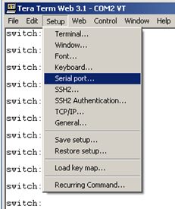
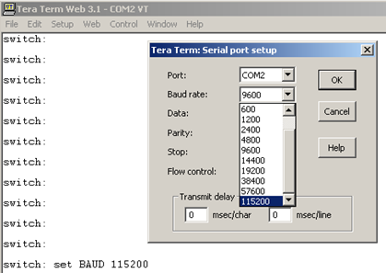
Adjust Tera Term to the new Speed

Slide 13
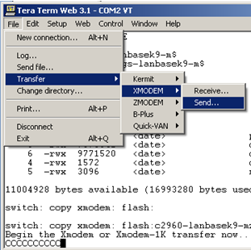
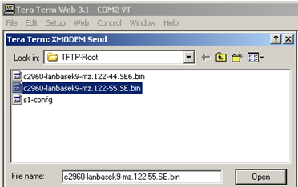
And Start the Transfer
On the Switch:
And then tell Tera Term to Transfer the file:
(Note: Don’t use the ‘Send file…’ option)

Slide 14
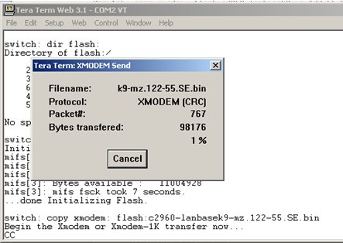

A Good Time for a Coffee Break

Slide 15
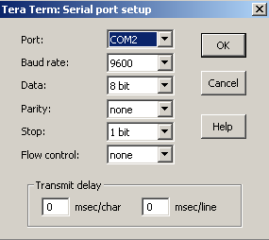
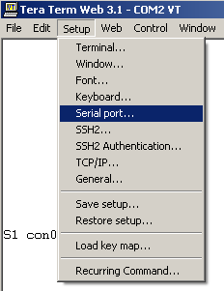

Reset the BAUD rate to 9600
And on Tera Term
On the Switch

Slide 16

Boot the Switch
II have indicated which IOS to boot, but this is not necessary if there is only one IOS present on the switch. ‘boot’ by itself is OK.

Slide 17
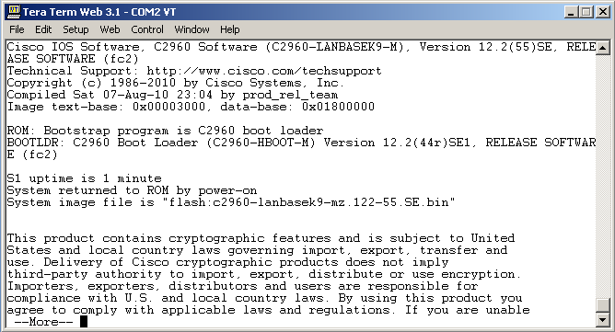
Show Version – Success!

Slide 18
Extracting a TAR file to the Switch

Slide 19
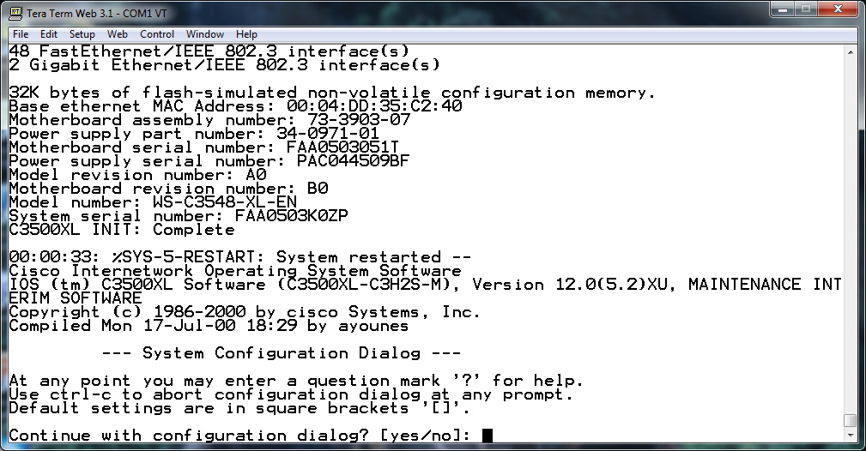
You have Switch that boots!
Now that your switch has a working IOS your almost there!

Slide 20
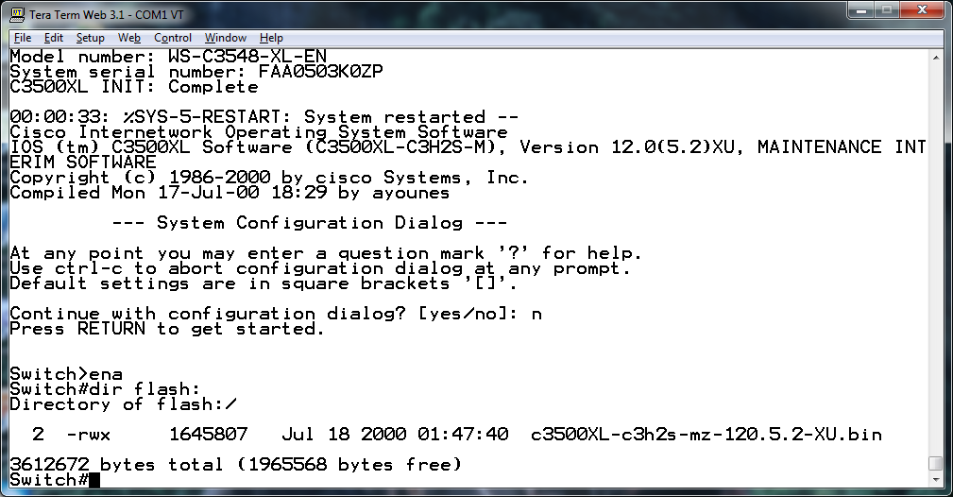
Your switch has an almost naked Flash!!
The only thing in your flash at this point should be the IOS.

Slide 21
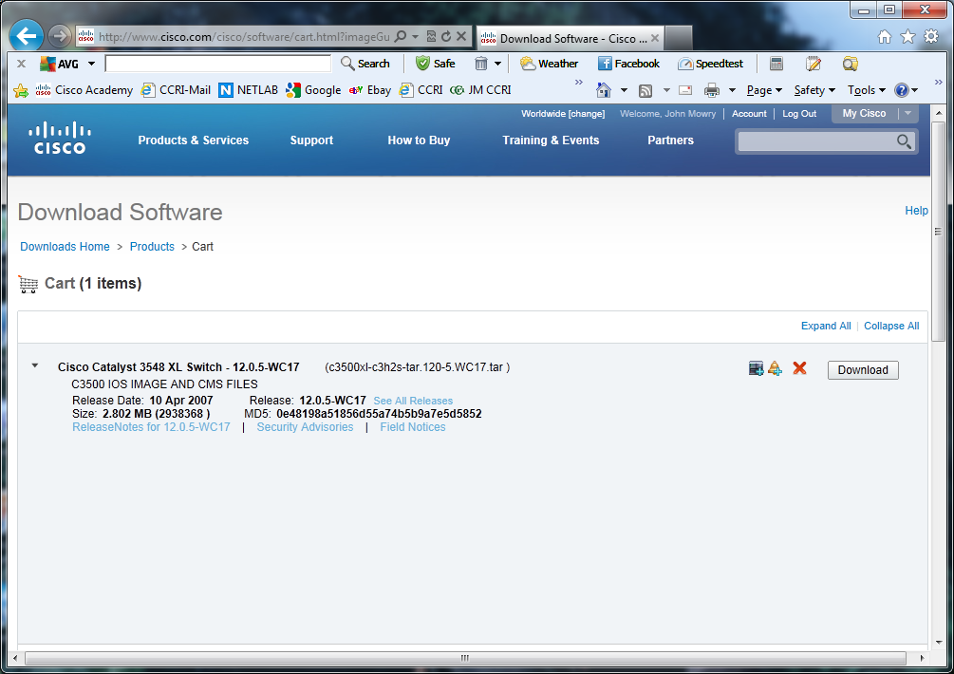
Get the TAR file to Extract
The TAR file for the IOS you want to eventually run on the switch has the IOS image as well as the CMS support files. You will need a CCO account to download this file!
*You can load a smaller image onto the switch via x-modem to speed the install process as all you need to do is get a working IOS before loading your production IOS.

Slide 22
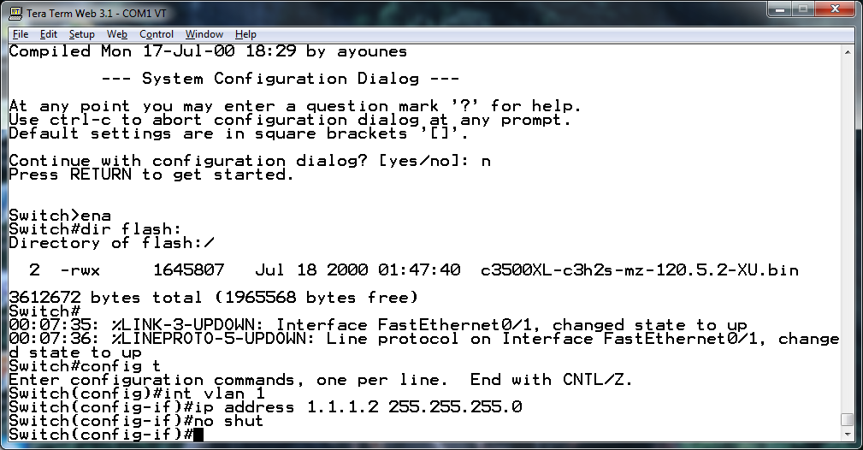
Give your switch an address!
Give your switch a management address so that you can establish a TFTP connection.
Switch(config)#int vlan 1
Switch(config-if)#ip address 1.1.1.2 255.255.255.0
Switch(config-if)#no shut
Switch(config-if)#.

Slide 23
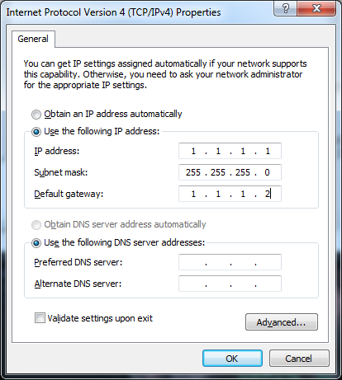
Give your TFTP server an address!
Assign your TFTP server an address.

Slide 24
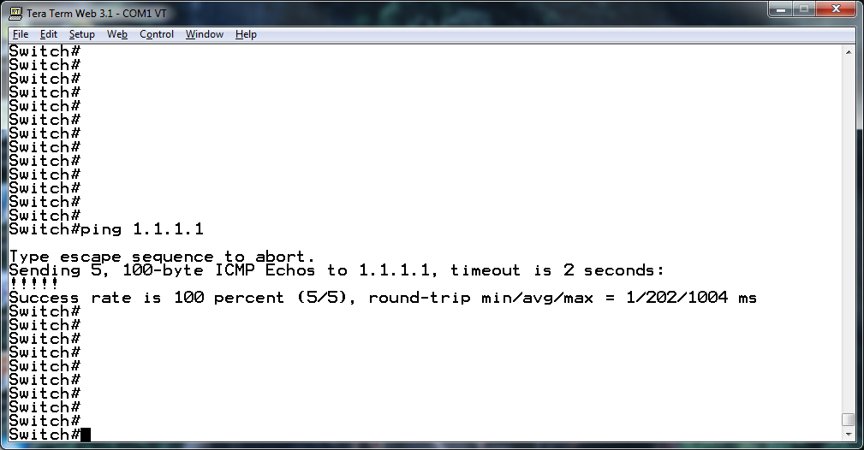
Connect to a TFTP server.
Establish a connection to a TFTP server where the TAR file is located. Use the “PING” command to verify conectivity.
Yes SUCCESS!

Slide 25
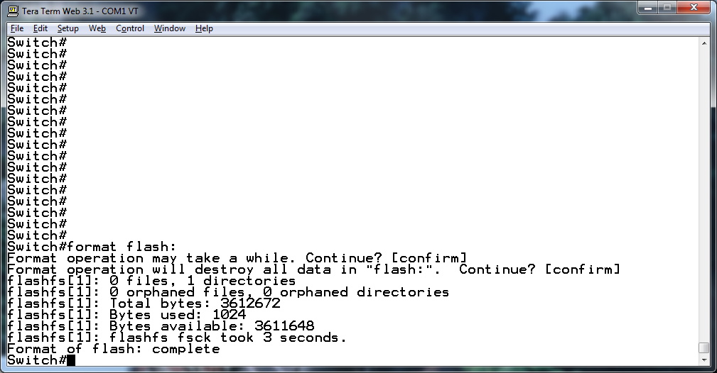
Format Flash! – Oh NO!!!!!
Now that you have the switch with a working IOS and it is running, your now about to do the scariest thing! Formatting the flash and erasing the IOS you just installed!

Slide 26
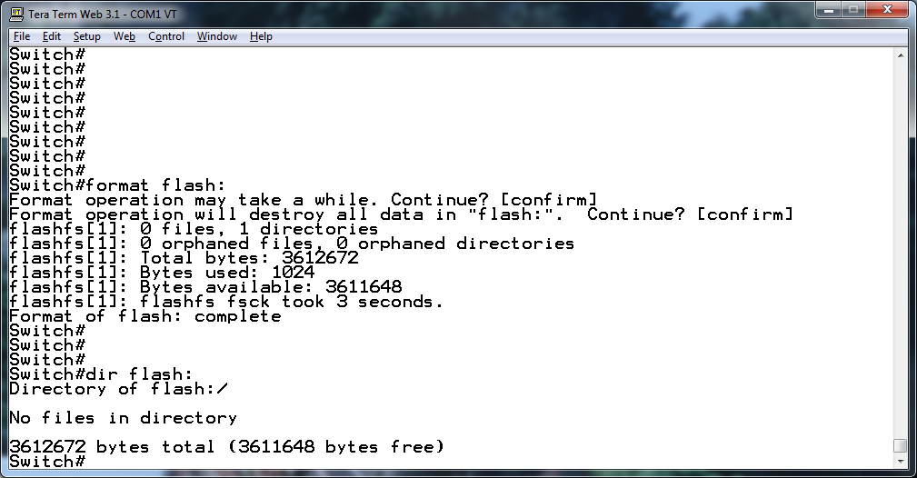
Your switch has a naked Flash!!
There is nothing in your flash now!
DO NOT SHUT THE POWER!

Slide 27
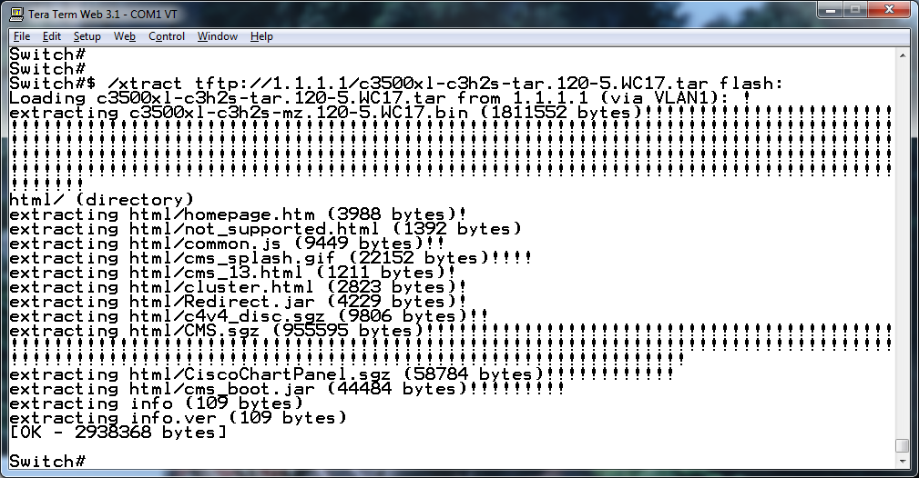
Extract your new IOS and CMS files!
Switch#archive tar /xtract tftp://1.1.1.1.c3500xl-c3h2s-tar.120-5.WC17.tar flash:

Slide 28
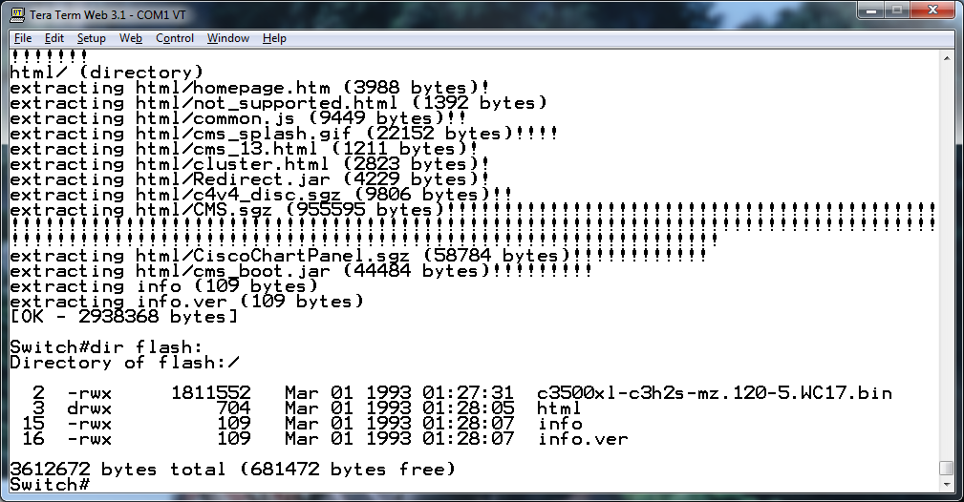
Your switch has an IOS and CMS files!
Your flash now has a complete operating system.

Slide 29
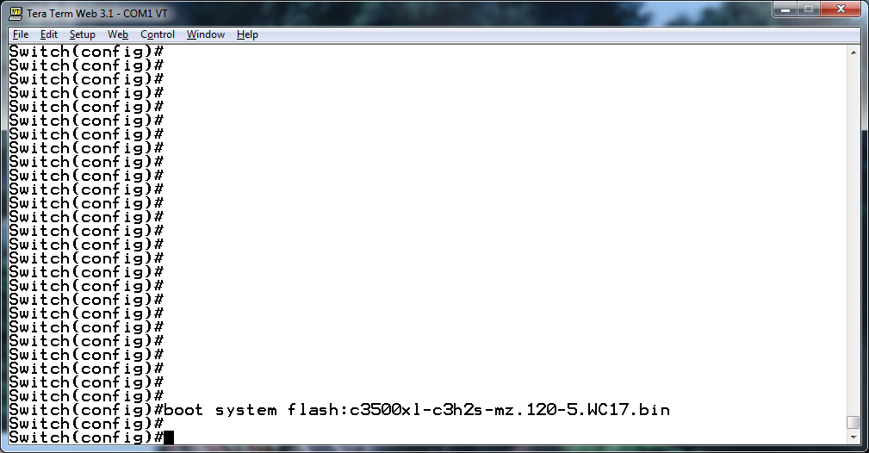
Almost done!
Tell your switch to use the new IOS
Switch(config)#boot system flash:c3500xl-c3h2s-mz.120-5.WC17.bin

Slide 30
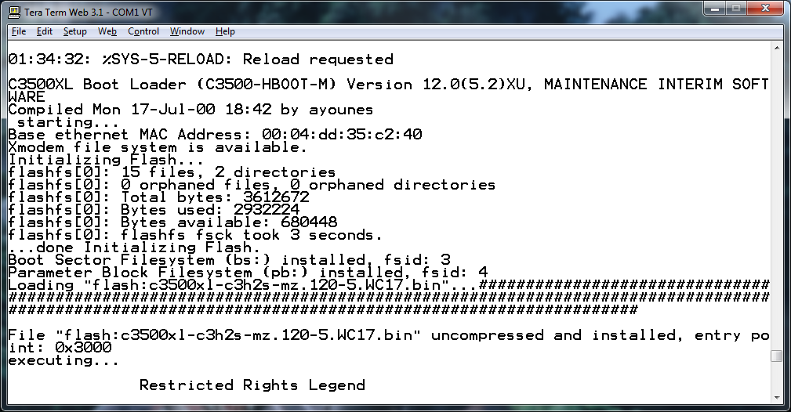
Test!
Reboot your switch to verify the boot image.
Your Done!

Slide 31
Booting a Router from a USB Flash Disk

Slide 32
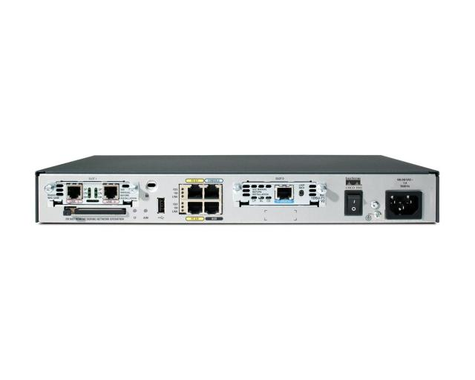
What Can You do with that USB Port?
Quite A Lot!

Slide 33
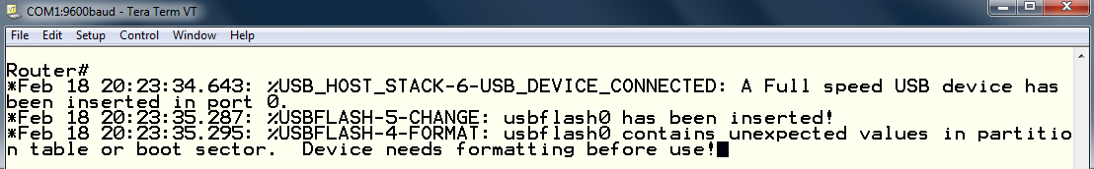
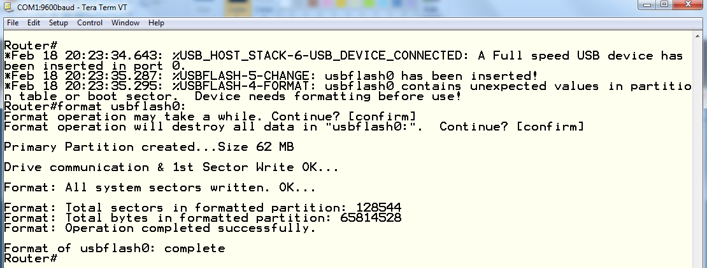
Insert a USB Flash Disk
Depending on the file system on your flash disk, the router may not be able to read it
From the command prompt, you can have the router format the disk.
Make sure you have saved any data and then format the disk.

Slide 34
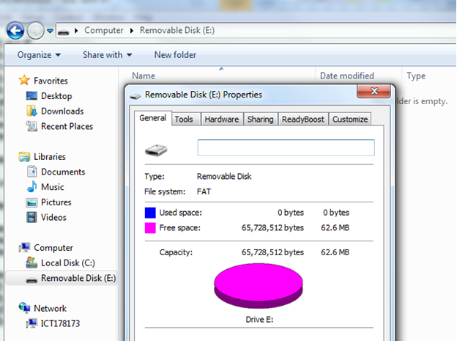
The Format will be FAT16

Slide 35
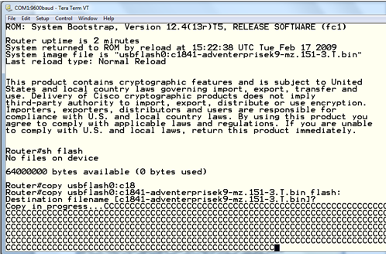
A Convenient Way to Copy to Your Router
Files can be copied to and from your Router using the usual copy command.
The Router sees the USB disk as usbflash0: or usbflash1: depending on router model and port.
The USB disk is immediately accessible once it is formatted and is visible when the router is booted to the IOS.

Slide 36
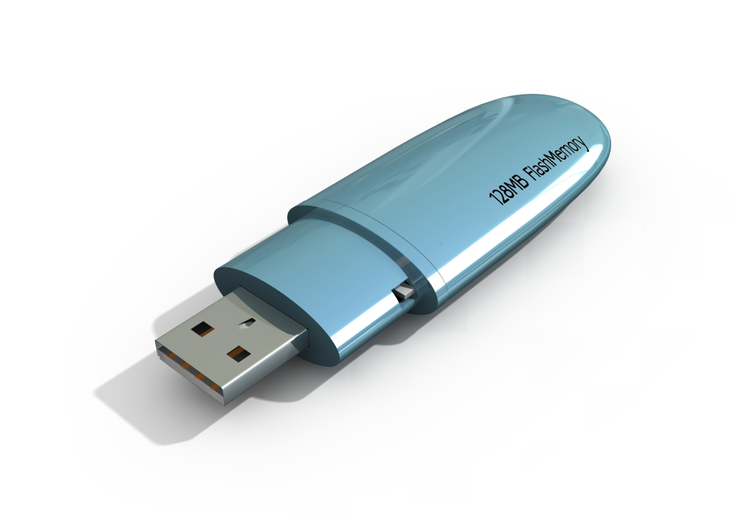
Booting the Router from a USB Flash Disk
If the Router IOS is missing, it will boot to ROMMON.
Your Router may not be able to see the USB flash disk from ROMMON.
A ROMMON upgrade will be required.
The ROMMON upgrade file can be downloaded from CCO using your Network Academy Maintenance agreement.

Slide 37
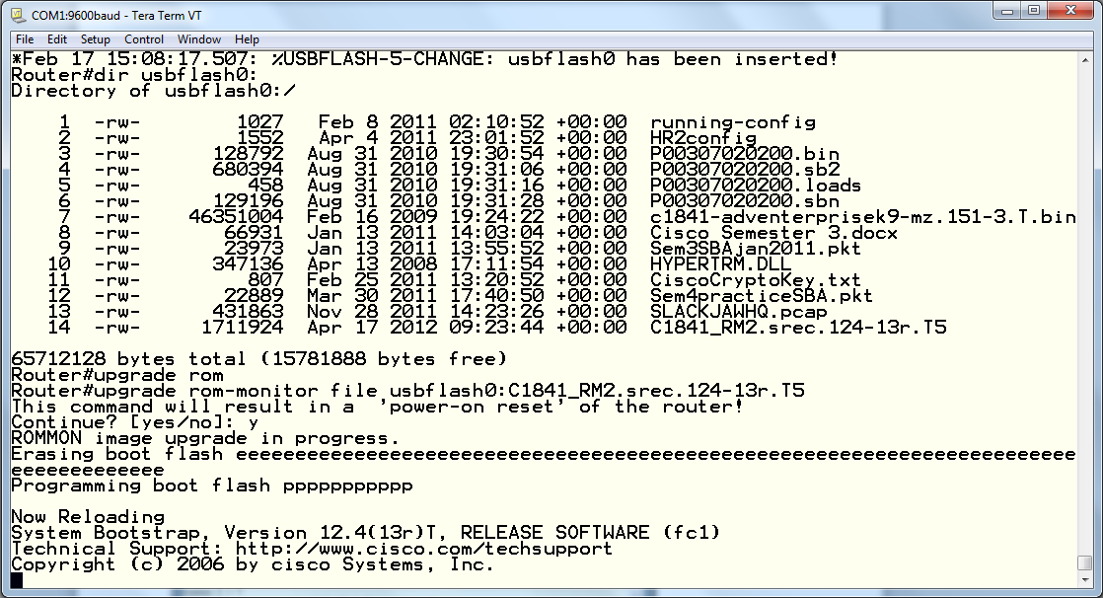
Upgrading ROM-Monitor
The current ROMMON upgrade for an 1841 router is the file: C1841_RM2.srec.124-13r.T5
In this image, the file is located on usbflash0:
‘upgrade rom-monitor file usbflash0: C1841_RM2.srec.124-13r.T5’
launches the rommon upgrade as illustrated.

Slide 38
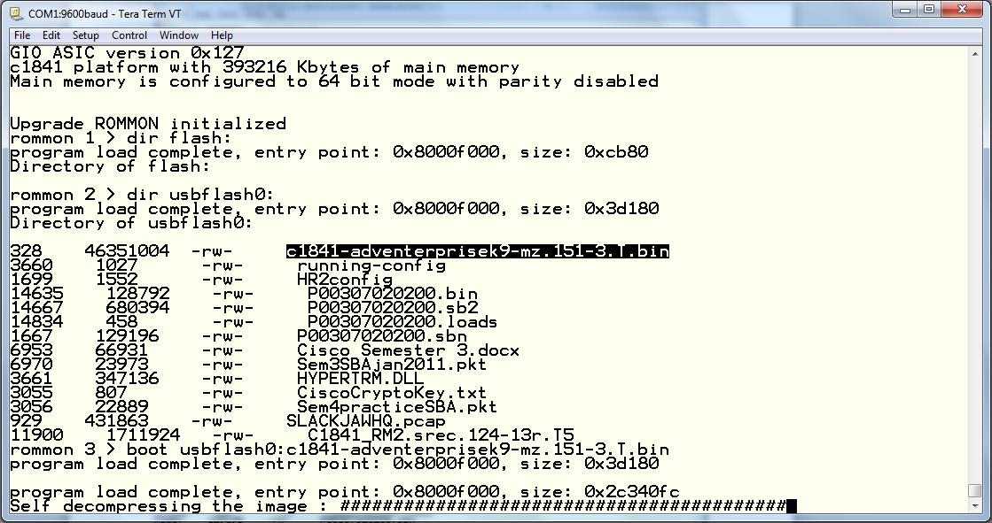
Booting the Router from USBFlash0:
There is nothing in the Router’s flash – NADA!
But – the IOS is available on usbflash0:
AND – with the rommon upgrade, it is Visible!
By specifying the IOS on usbflash0:, we are able to boot the router from this image.

Slide 39
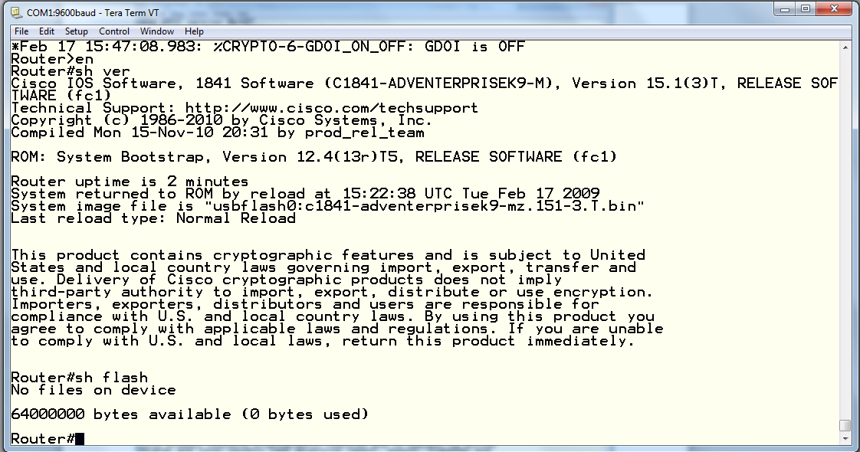
The Boot is Successful
‘show version’ confirms that the router booted from the IOS on usbflash0:
The IOS is still not located in the Router’s flash.
Curiously, the ‘copy’ command is not available in ROMMON.

Slide 40
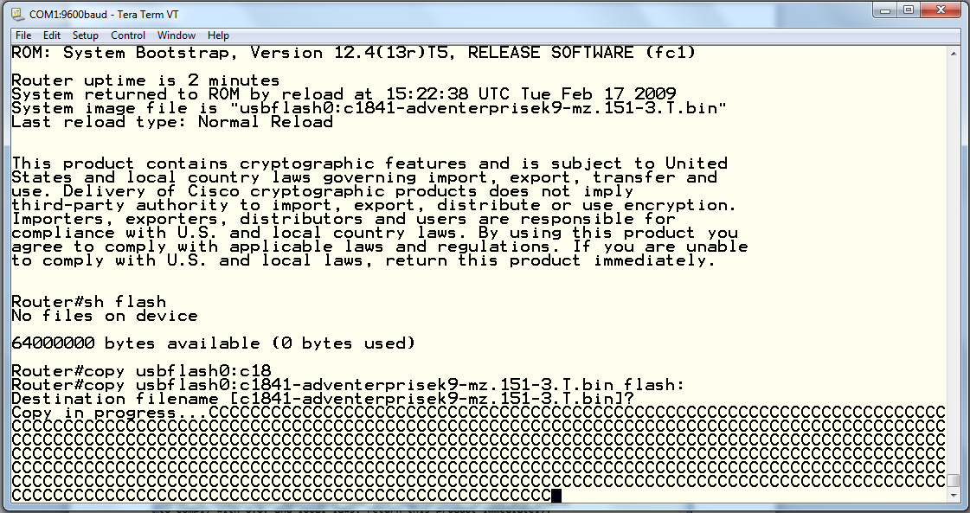
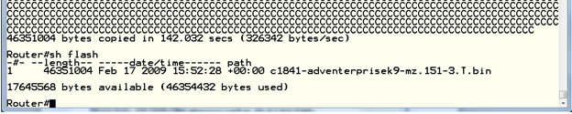
Restoring the IOS to the Router
Copy the IOS from usbflash0: to the Router’s flash
The copy is successful and the Router is back in Service!

Slide 41

Questions?

Slide 42



Slide 43
Auxiliary slides follow
< drop any extra slides after this one to keep them close at hand but outside of the main presentation slide area –
use if time allows and for Q&A >

Slide 44
Upgrade Switch IOS using TFTP
Occasional upgrades are needed either for increased functionality or for bug fixes.
A TFTP server is required. Several free versions are available. Solar Winds is being used.
A working Ethernet connection is required between Switch and TFTP server.
We will be using 192.168.1.1/24 on TFTP server and 192.168.1.2/24 on Switch vlan1.

